Slide 1
V UNIT

Slide 2
Concept
The term “collective bargaining” simply means negotiation.
It provides an opportunity to the workers to achieve industrial democracy.
The right to bargain collectively with an employer enhances the human dignity, liberty and autonomy of workers by giving them the opportunity to influence the establishment of workplace rules and thereby gain some control over a major aspect of their lives, namely their work.
Collective bargaining is not simply an instrument for pursuing external ends…rather it is intrinsically valuable as an experience in self-government.
Collective bargaining permits workers to achieve a form of workplace democracy and to ensure the rule of law in the workplace. Workers gain a voice to influence the establishment of rules that control a major aspect of their lives

Slide 3
Definition
“Collective bargaining is the term used to describe a situation in which the essential conditions of employment are determined by bargaining process undertaken by representatives of a group of workers on the one hand and of one or more employers on the other.”
Collective bargaining is a voluntary process under which the representatives of both employers and labour enter into an agreement. We also note that the process does not stop as soon as a bargain is reached at between the employer and the trade union. It is a continuous process because the contract is only the beginning of collective bargaining. Bargaining requires an efficient and permanent arrangement for negotiations. No temporary or one-time arrangements can make the bargaining process successful.

Slide 4
COLLECTIVE BARGAINING
It is an agreement between a single employer or an association of employers on the one hand and a labour union on the other, which regulates the terms and conditions of employment”.
collective bargaining is a process of discussion and negotiation between two parties, one or both of whom is a group of persons acting in contest…. more specifically it is the procedure by which an employer or employers and a group of employees agree upon the conditions of work”

Slide 5
OBJECTIVES:-
1. To provide an opportunity to the workers to voice.
2. To reaching a solution that is acceptable.
3. To maintain cordial relation.
4. To promote democracy. To prevent unilateral action to employees.
5. To preventing strike and enhance the productivity.
6. To Resolving and prevent all conflicts and disputes in a mutually agreeable manner.
7. To develop a conducting atmosphere .
8. To provide stable and peaceful organization (hospital).

Slide 6
Aims and Objectives
1. Balances the Legitimate Expectations 2. Maintain Equality
3. Promote Industrial Democracy
4. Rule-making Function

Slide 7
Main Features
It is a collective process :The representatives of both workers and management participate in bargaining.
It is a continuous process: It establishes regular and stable relationship between the parties involved. It involves not only the negotiation of the contract, but also the administration of the contract.
It is a flexible and dynamic process: The parties have to adopt a flexible attitude through the process of bargaining.
It is a method of partnership of workers in management.

Slide 8
Subject-matter of Collective Bargaining
Collective bargaining has two pronged concerns: (1) Chalking out a broad contract of employment relationship between employers and workers, and (2) The administration of the contract. In fact, it has been recognised as a method of determining the wage rates and other terms and conditions of employment and of regulating the relations between the management and organised labour. Collective bargaining includes provisions with respect to hiring, lay-offs, promotions, transfers, work scheduling, work assignment, wages, welfare programmes, retirement benefits, discipline, etc. The Indian Institute of Personnel Management suggested the following subject matter of collective bargaining: # Purpose of agreement, its scope, and the definition of important terms; # Rights and responsibilities of the management and of the trade union; # Wages, bonus, production norms, leave, retirement benefits, and terms and conditions of service; # Grievance redressal procedure; # Methods and machinery for the settlement of possible future disputes; # Termination clause.

Slide 9
Types of Bargaining
CONJUNCTIVE OR DISTRIBUTIVE BARGAINING: Conjunctive bargaining is the most common type of bargaining & involves zero-sum negotiations, in other words, one side wins and the other loses. Both parties try to maximize their respective gains. They try to settle economic issues such as wages, benefits, bonus, etc. For Example, Unions negotiate for maximum wages & the management wants to yield as little as possible – while getting things done through workers.
COOPERATIVE /INTEGRATIVE BARGAINING: Integrative bargaining is similar to problem solving sessions in which both sides are trying to reach a mutually beneficial alternative, i.e. a win-win situation. Both the employer & the union try to resolve the conflict to the benefit of both parties. Both sides share information about their interests and concerns and they create a list of possible solutions to best meet everyone's needs.

Slide 10
PRODUCTIVITY BARGAINING: A form of collective bargaining leading to a productivity agreement in which management offers a pay raise in exchange for alterations to employee working practices designed to increase productivity. Productivity bargaining has been described as "an agreement in which advantages of one kind or another, such as higher wages or increased leisure, are given to workers in return for agreement on their part to accept changes in working practices or in methods or in organization of work which will lead to more efficient working.
COMPOSITE BARGAINING: Workers believed that productivity bargaining agreements increased their workloads. Rationalization, introduction of new technology, tight productivity norms have added to this burden and made the life of a worker some what uneasy. As an answer to such problems, labour has come in favour of composite bargaining. In this method, labour bargains for wages as usual, but goes a step further demanding equity in matters relating to work norms, employment levels, manning standards and environmental hazards etc.

Slide 11
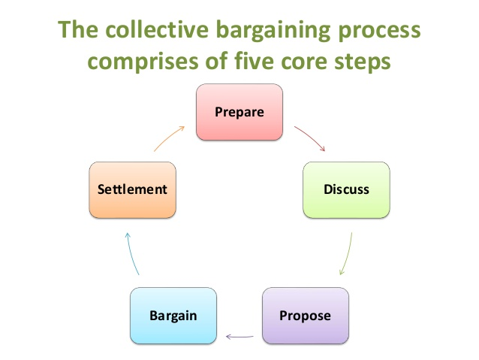

Slide 12
ADVANTAGE OF COLLECTIVE BARGAINING:-
1) Provide security to workers
2) Prohibits the strikes
3) Give employee a voice
4) Reduced bias and favouritisms
DISADVANTAGE OF COLLECTIVE BARGAINING:-
1) Not all people will agree
2) loss of authority
3) Reduced management hand in business

Slide 13
Pre-requisites
Please understand that effective negotiations and enforcement requires a systematic preparation of the base or ground for bargaining which involves the following three steps
1. Recognition of the Bargaining Agent : The management should give recognition to the trade union for participating in the collective bargaining process. In case there is more than one union, selection could be done through verification of membership by a government agency giving representation to all the major unions through joint consultations. Thus, the bargaining agent of the workers should be properly identified before initiating any action. 2. Deciding the Level of Bargaining : Whether the dealings are confined to enterprise level, industry level, regional or national level should be decided as the contents, scope and enforcement agencies differ in each case. 3. Determining the Scope and Coverage of Bargaining : It would be better to have a clear understanding of what are the issues to be covered under bargaining. Many a time, bargaining is restricted to wage and working conditions related issues but it would be advantageous for both the management and union to cover as many issues as possible to prevent further friction and disputes. Therefore, all the important and interrelated issues are to be taken for consideration.

Slide 14
Workers participation in management
A system of communication and consultation, either formal or informal, by which employees of an organization are kept informed about the affairs of the undertaking and through which they express their opinion and contribute to the management decisions.
Objectives:
To elevate worker’s status in industry.
To promote democratic practice.
Increase productivity with joint efforts.
Promote cordial relations.

Slide 15
IMPORTANCE OF WPM:
• Reduced industrial conflict
• Reduced misunderstandings
• Higher productivity
• Better communication
• Industrial democracy
• Less resistance to change
SUCCESS OF WPM:
• Strong, democratic and representative unionism
• Mutually agreed objectives
• Effective consultation of workers
• Faith and Legislative support
• Education and training
• Specific guidelines

Slide 16
Levels of WPM:
Information participation: It ensures that employees are able to receive information and express their views pertaining to the matter of general economic importance.
Consultative importance: Here workers are consulted on the matters of employee welfare such as work, safety and health. However, final decision always rests with the top-level management, as employees’ views are only advisory in nature.
Associative participation: It is an extension of consultative participation as management here is under the moral obligation to accept and implement the unanimous decisions of the employees. Under this method the managers and workers jointly take decisions.
Administrative participation: It ensures greater share of workers’ participation in discharge of managerial functions. Here, decisions already taken by the management come to employees, preferably with alternatives for administration and employees have to select the best from those for implementation.
Decisive participation: Highest level of participation where decisions are jointly taken on the matters relating to production, welfare etc.

Slide 17
Forms of participation
Suggestion schemes : A suggestion box is installed and any worker can write his suggestions and drop them in the box. Periodically all the suggestions are scrutinized by the suggestion committee or suggestion screening committee.
Works committee: Works committee deals with matters of day-to-day functioning at the shop floor level. Works committees are concerned with: Conditions of work such as ventilation, lighting and sanitation. Amenities such as drinking water, canteens, dining rooms, medical and health services. Educational and recreational activities. Safety measures, accident prevention mechanisms etc
Joint Management Councils: Wages, bonus, personal problems of the workers are outside the scope of Joint management councils. The council is to take up issues related to accident prevention, management of canteens, water, meals, revision of work rules, absenteeism, indiscipline etc.
Work directors: One or two representatives of workers are nominated or elected to the Board of Directors.
Co-partnership: Co-partnership involves employees’ participation in the share capital of a company in which they are employed. By virtue of their being shareholders, they have the right to participate in the management of the company.
Joint Councils: The joint councils are constituted for the whole unit, in every Industrial Unit employing 500 or more workers, there should be a Joint Council for the whole unit. Only such persons who are actually engaged in the unit shall be the members of Joint Council.
Shop councils: Shop council represents each department or a shop in a unit. Each shop council consists of an equal number of representatives from both employer and employees

Slide 18
MANAGEMENT OR WORKS COMMITTEE
A committee composed of both employer and employees convened to discuss matters of common interest concerning a factory, plant, business policy, etc, not covered by regular trade union agreements.
A body representing the workers of a plant, factory, etc, elected to negotiate with the management about working conditions, wages,etc.
The works committee- set up under the INDUSTRIAL DISPUTE ACT,1947.
Under this Act, every establishment employing 100 or more workers is required to constitute a works committee as a scheme of workers participation in management.
It consists of equal number of representatives from the employer and the employees.

Slide 19
The main aim to establish works committee is to promote measures for maintaining harmonious relations in the work place and to sort out differences of opinion on work related issues. E.g. Work conditions and benefits. Such other objectives are:
To negotiate on the matters of general interests.
To maintain industrial peace.
To share the workload
To encourage workers to have a say
To get ideas for the workplace and workers.

Slide 20
Structure:
President: Employer Nominee
Vice-president: Worker’s Representative Secretary
Joint Secretary
Tenure: 2 Years
Total Strength: 20
Compulsory for every undertakings employing 100 or more workers.

Slide 21
Functions: Works committee deals with matters of day-to-day functioning at the shop floor level. Works committees are concerned with:
a. Health: Ventilation, Lighting, Temperature and Sanitation facilities.
b. Safety: Accident Prevention, Occupational diseases and Protective equipments.
c. Welfare: Rest rooms, medical and health services, drinking water.
d. Administration of welfare and fine funds.
e. Educational and recreational activities. E.g. Health, Safety and Welfare committee.
f. Adjustments of festivals and national holidays.
g. Promotion of thrift and savings.
h. To see that the decisions taken in the works committee are fully enforced.

Slide 22
TRIPARTISIAM
The active interactions among the government, workers and employers as equal and independent social partners.
The “Tripartite System” enables:
The representatives of workers and employers to participate on an equal footing with those of governments in all discussions ,decision-makings and dispute settlement.

Slide 23
Tripartism: Structure of ILO
Governments
ILO
Employers
Workers

Slide 24
Tripartite forums evolve norms or standards in the form of guidelines. There are a number of tripartite bodies which operate at the Central and State levels.
Industrial relations in India have been shaped largely by principles and policies evolved through tripartite consultative machinery at the industry and national levels.

Slide 25
The purpose of the tripartite body
Bring the aggravated parties together for mutual settlement of differences, and encourage a spirit of cooperation and goodwill.
Promote uniformity in labor laws and legislation.
Discuss all matters of All India importance as between employers and employees.
Determine a plan for settlement for all disputes.

Slide 26
Evolution of Tripartite Bodies
The Whitley Commission, in 1931,recommended a body be set up to look into the needs for consultation on labour matters. It envisaged a statutory organization which should ensure adequate representation of the various interests involved : employers, labour and government. They recommended that labour members should be elected by registered trade unions and employers’ representatives should be elected by their association. They should meet regularly.
It was only after the 4th Labour Conference held in 1942 that permanent tripartite collaboration machinery was set up – Indian Labour Conference (ILC) and Standing Labour Committee (SLC)

Slide 27
Indian Labour Conference (ILC) and Standing Labour Committee (SLC)
Indian Labour Conference (ILC) and Standing Labour Committee (SLC) are both important constituents of tripartite bodies and play a vital role in shaping the IR system of the country.
They have been constituted to suggest ways and means to prevent disputes.
The representatives of the workers and employers are nominated to these bodies by the Central Government in consultation with the All-India organizations of workers and employers.
The Labour Ministry settles the agenda for ILC/SLC meetings after taking into consideration the suggestions sent to it by member organizations.
These two bodies work with minimum procedural rules to facilitate free and fuller discussions among the members.
The ILC meets once a year, whereas the SLC meets as and when necessary.

Slide 28
ILC and SLC
The function of ILC is to “ advise the Government of India on any matter referred to it for advice, taking into account suggestions made by the provincial government, the states and representative of the organizations of workers and employers”
The function of SLC is to “ consider and examine such questions as may be referred to it by the Central Government and to render advice, taking into account the suggestions made by various governments, workers and employers”.

Slide 29
The objectives of ILC are:
Setting up of bipartite works committees, joint consultative and production committees.
Adoption by employers and unions of a voluntary code of discipline;
Following proper grievance and disciplinary procedures;
Deciding norms for fixing need based wages;
Rationalizing and revising wage structures of important industries through non-statutory wage boards; and
Encouraging voluntary arbitration for the settlement of industrial disputes.

Slide 30
Labour advisory boards
The International Labour Organization (ILO) is a specialized agency of the United Nations system which seeks the promotion of social justice and internationally recognized human and labour rights.
The International Labour Organization (ILO) was founded, along with the League of Nations, by the Treaty of Versailles on 11 April 1919.
In 1946, the ILO became the first specialized agency associated with the newly formed United Nations, following the dissolution of the League of Nations . On its 50th anniversary in 1969, the ILO was awarded the Nobel Peace Prize .
The ILO formulates international labour standards. These standards take the form of Conventions and Recommendations, which set minimum standards in the field of fundamental labour rights.

Slide 31
International Labour Organisation
The ILO provides technical assistance, mainly in the following fields:
vocational training and vocational rehabilitation;
employment policy;
labour administration;
labour law and industrial relations;
conditions of work;
management development;
social security;
labour statistics, and occupational safety & health.

Slide 32
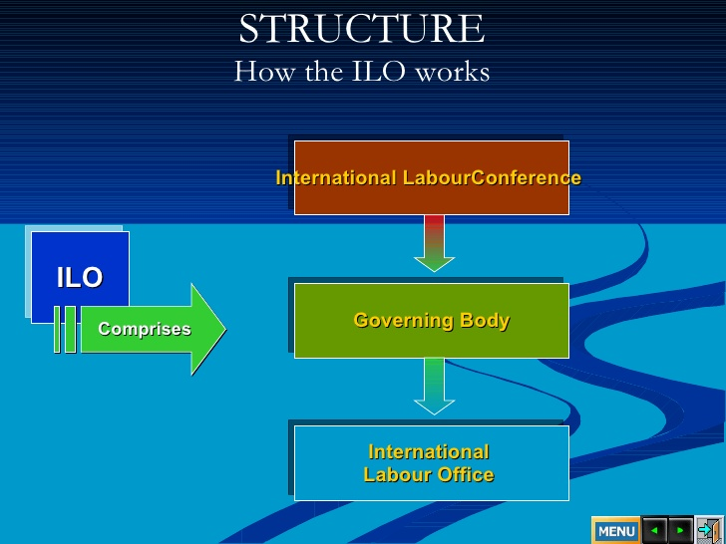

Slide 33
International Labour Conference
The ILC meets in June every year, in Geneva, and is the highest authority of the ILO.
It sets minimum international labour standards and defines the broad policies of the Organization.
Every two years, the Conference adopts the ILO’s biennial work programme and budget, which is financed by member States .
The ILC also provides an international forum for the discussion of world labour and social problems.
The ILC elects the Governing Body of the ILO.
International Labour Conference Each member State has four representatives (One Employer representative, Two Government representatives, One Worker representative)

Slide 34
Governing Body
The Governing Body is the executive council of the ILO which establishes the strategic objectives and policies.
The Governing Body meets three times a year in Geneva and makes decisions on ILO policy and establishes the programme and budget, which it subsequently submits to the Conference for adoption.
The Governing Body also elects the Director-General for a five-year renewable term. The ten States of chief industrial importance have permanent seats on the Governing Body, while the other members are elected at the Conference every three years from representatives of the other member countries, taking into account geographical distribution.
Employers and workers elect their own representatives independently of one another. Governing Body includes (14 Employer representatives 28 Government representatives 14 Worker representatives).

